Slide 1

Basic Details of the Team and Problem Statement
Ministry/Organization Name/Student Innovation: MSME
PS Code: RK1121
Problem Statement Title: Developing virtual reality based solution.
Team Name: VROOM.
Team Leader Name: Surya Narayanan CS.
Institute Code (AISHE): 1-3512999651.
Institute Name: Sona college of technology.
Theme Name: Software.

Slide 2
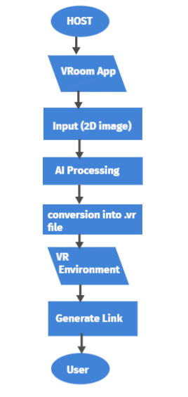
Idea:
The project provides a virtual Environment which uses the potential of Virtual Technology.
To Enable users from different context and different sectors to meet and interact.
Users can experience the customized digital content.
It gives free erudition in a virtual settings and supports collaborative erudition through simulation and live interaction.
HARDWARE REQUIREMENTS:
Integrated Webcam
VR Box
SOFTWARE REQUIREMENTS:
Unity/Unreal engine
Blender
Open CV
AWS
STACK TECHNOLOGIES:

Slide 3
Our Prototype:
Highlights:
This can be adaptable to others sectors such as healthcare, architecture and Law Enforcement.

Slide 4
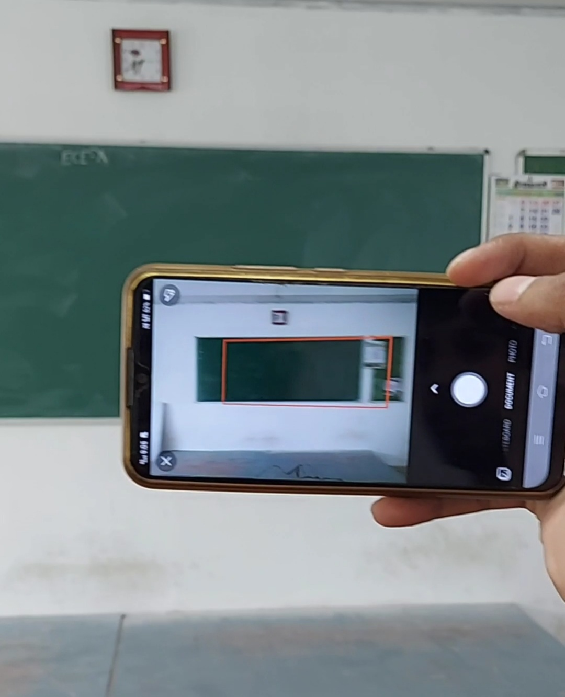
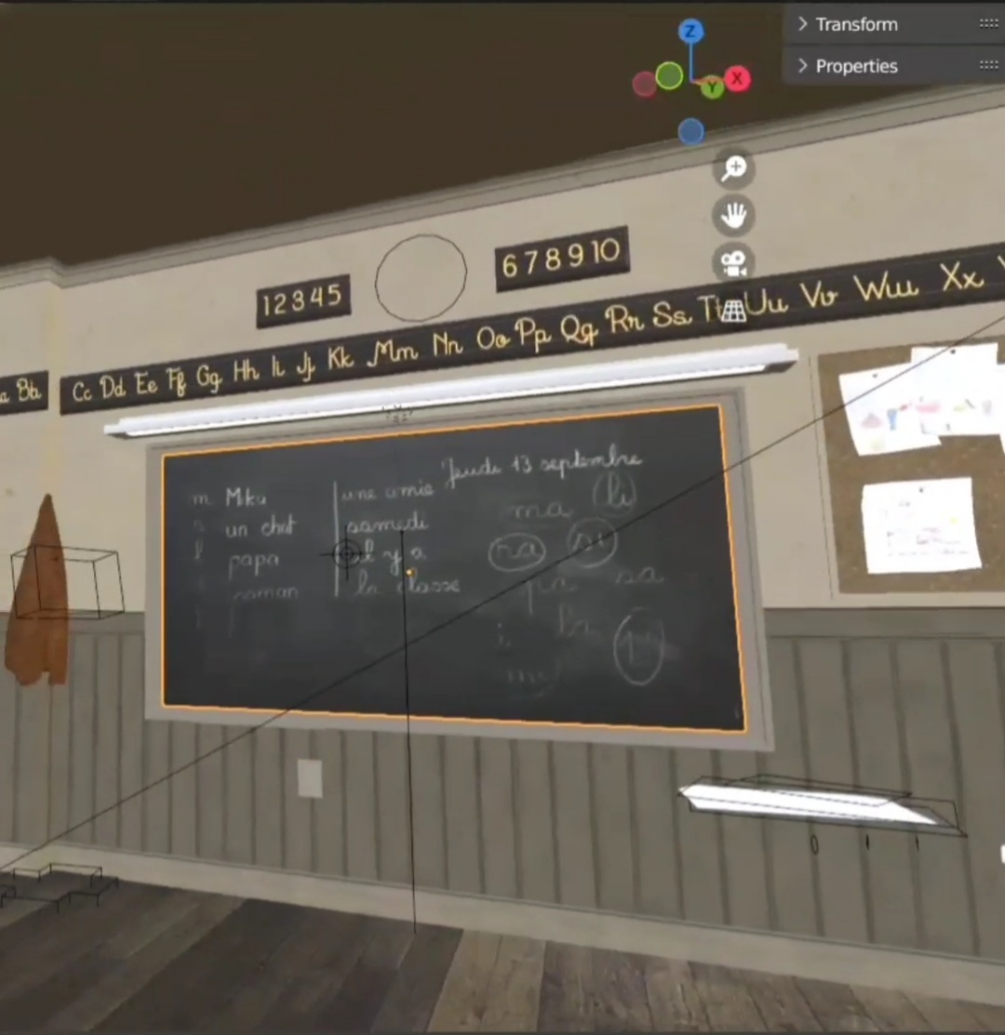
APPROACH:
USE CASES:
Vroom App
Input (Image)
HOST
.VR file
Rendering
USER
DEPENDENCIES:
Internet Connectivity.
Device with Gyroscope.
Generate link
VR Environment

